Slide 1
Action Recognition from Sports Videos using Multimodal Transfer Learning
Modern AI System for Sport and Motion Recognition

Slide 2
Problem Statement
Traditional models struggle to identify sports actions accurately in real-time videos.
We aim to build a deep learning system that can classify human sports actions (e.g., cricket, badminton, basketball) using transfer learning for improved accuracy and efficiency.
Understanding spatial (frame-wise) and temporal (motion) patterns.
Traditional CNNs fail to capture motion continuity, So integrating CNN with LSTM/RNN.

Slide 3
Motivation
To build a model that understands both appearance and motion, surpassing "image-only" models
Growth of computer vision and deep learning in real-world Applications
Real-world applications: sports analytics, surveillance
To design a practical, high-performance model that can be successfully trained even with the limited resources of a platform like Google Colab

Slide 4
Project Objective
Implement a CNN–LSTM based model for recognizing human sports activities
Apply Transfer Learning using pre-trained CNNs (MobileNetV2)
Train on sports action video datasets and evaluate performance
A trained, high-accuracy model for 63 sports classes from the UCF-101 dataset

Slide 5
Scope Of The Project
Recognize sports actions like cricket, football, badminton, basketball etc.
Focus on video-based human action recognition.
Use transfer learning to reduce data and training time requirements.
Target applications in sports analytics, surveillance, and health monitoring.

Slide 6
System Overview
Our model combines:
CNN → extracts spatial features from each frame.
LSTM → captures temporal dynamics between frames.
Transfer Learning → reuses knowledge from pre-trained models.
Result → high-accuracy recognition with less training data.

Slide 7
Core Idea
Combine spatial (CNN) and temporal (LSTM) modeling with transfer learning (MobileNetV2).
Stream 1 (Spatial): RGB Frames -> TimeDistributed(MobileNetV2) -> LSTM -> "What" Summary
Stream 2 (Temporal): Optical Flow -> TimeDistributed(Custom CNN) -> LSTM -> "How" Summary
Fusion: We concatenate both summaries into a single (512)-unit vector.
Classifier: The final vector is fed into a Dense(1024) -> Dense(63) to get the final prediction.

Slide 8
Architecture Overview
Base Model: MobileNetV2 (pre-trained on ImageNet)
Added Layers:
CNN
LSTM(256)
Combined Input(512)→Dense(1024)→Dense(63) → Softmax
Optimizer: Adam
Loss Function: Categorical Crossentropy (standard for multi-class classification)

Slide 9
System Workflow
Capture or load video dataset
Frame extraction
Data preprocessing and augmentation
Feature extraction using CNN
Sequence modeling using LSTM
Classification into sports categories

Slide 10
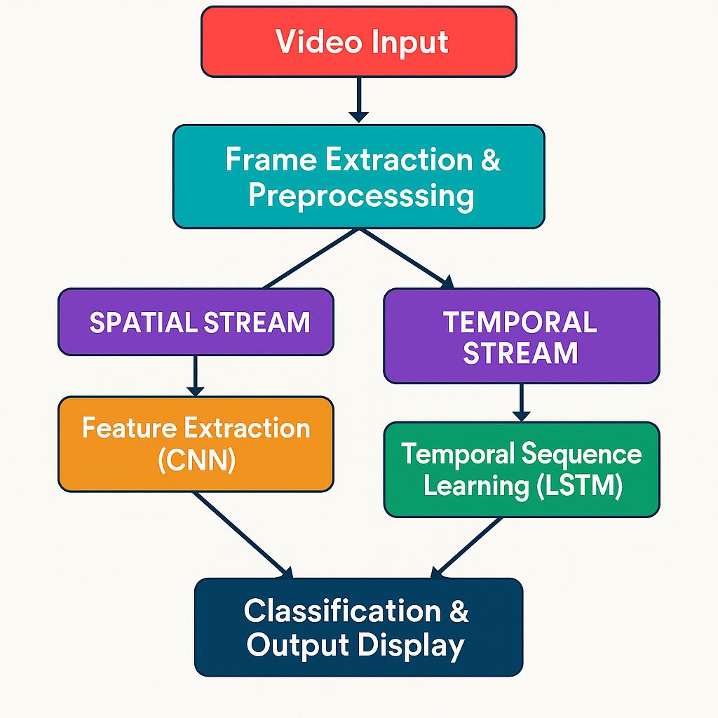
Spatial vs Temporal
Spatial Frame : Static Frame Information Temporal Frame : Motion across Frames Both are needed for activity recognition.

Slide 11
Modules Overview
Transfer Learning Module
Activity Recognition Module

Slide 12
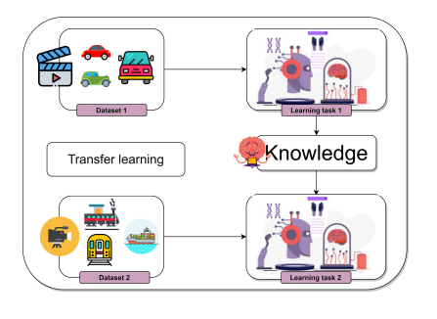
Transfer Learning Module
Uses CNN for extracting frame-level features
dynamically.
Converts video into frame sequences.

Slide 13
Transfer learning module (cont.)
Reuses CNNs trained on MobileNetV2
Extracts high-level features efficiently.
Transfer Learning Explanation
Freeze convolutional layers of MobileNetV2
Fine-tune on sports dataset
Benefits:
Faster convergence
Higher accuracy
Lower overfitting risk

Slide 14
Activity Recognition
LSTM layers analyze sequential frames
Outputs probability of each sport category
Softmax layer predicts the most likely sport using the maximum probability among all classes

Slide 15
CNN as Feature Extractor
Extracts features per frame (edges, limbs, objects). Output fed to LSTM.
Few crucial Working Steps:
Input Frames: Each video is divided into multiple frames (e.g., 20 per clip).
Preprocessing: Frames resized to 128x128 and normalized.
Feature Extraction:
For each frame, CNN outputs feature map (1280 feature maps per frame)

Slide 16
LSTM for Temporal Dynamics
Learns motion over frames; handles variable-length sequences; retains memory using gates.
Captures sequential motion patterns.
Learns dependencies between consecutive frames.
Helps model temporal context (e.g., ball hit → jump → shot).

Slide 17
Dataset – UCF101
8,500+ video clips across 63 action classes
Split: 80% Training | 20% Validation
Sample Classes: Cricket, Basketball, Badminton, Tennis, Volleyball etc.

Slide 18
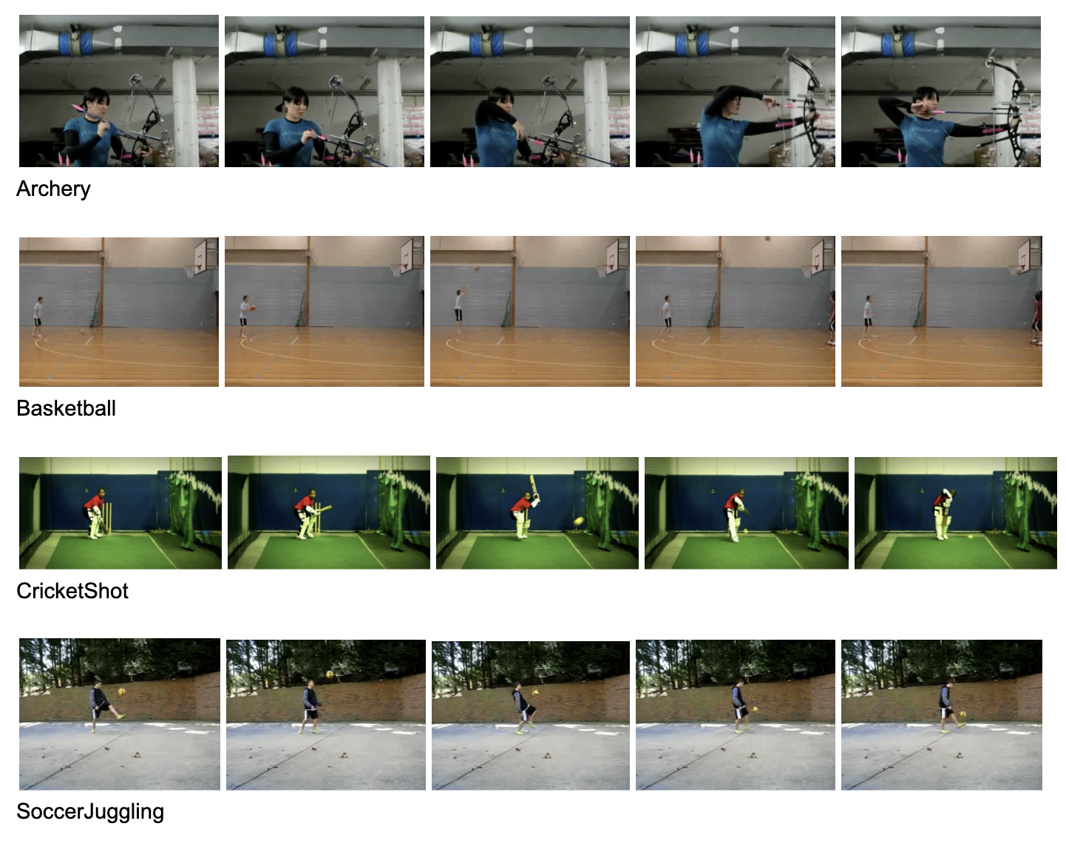

Slide 19
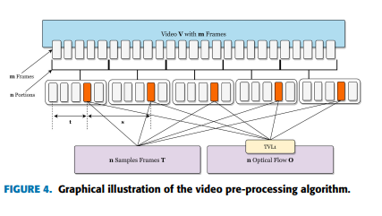
Data Preprocessing
Extract 20 frames per video.
Resize to pixels 128X128.
Normalize pixel values (0.0–1.0).

Slide 20
Model Training Setup
Language: Python 3.10
Frameworks: TensorFlow 2.x, Keras
Environment: Google Colab
Hardware: Tesla T4
Model Configuration:
Base Network (Transfer Learning): MobileNetV2 (pre-trained on ImageNet)
Added Layers:
CNN Layers
LSTM (256 units)
Dense(1024) → Dense(63) → Softmax output
Optimizer: Adam ( learning rate = 0.001)
Loss Function: Categorical Crossentropy

Slide 21
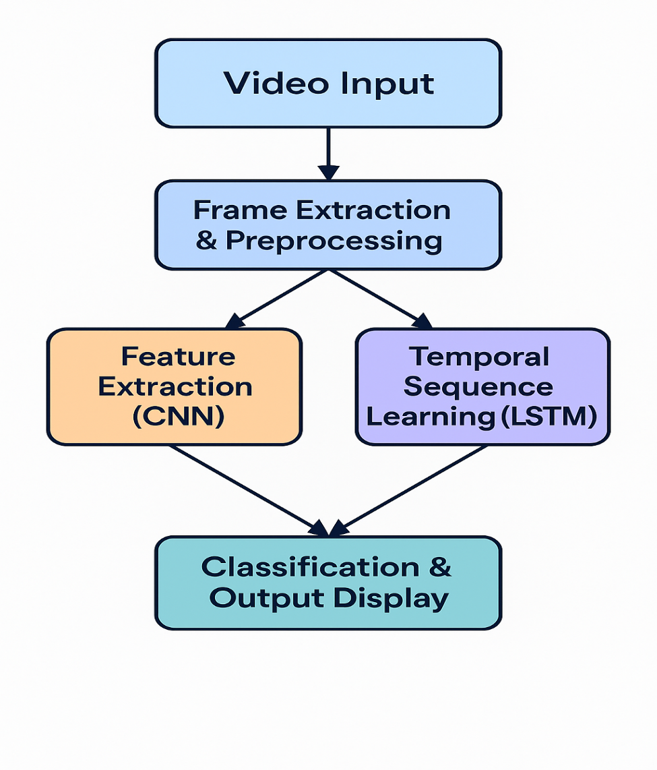
Training Flow

Slide 22
Evaluation Metrics
Accuracy, Precision, Recall, F1 Score
Accuracy = (TP + TN) / (TP + TN + FP + FN)
Precision = TP / (TP + FP)
Recall = TP / (TP + FN)
F1–Score = (2*TP)/(2*TP+FP+FN).

Slide 23
Results
CNN+LSTM : 89.3% Accuracy
Model | Accuracy | Precision | Recall | F1 score
Baseline CNN | 0.72 | 0.74 | 0.73 | 0.72
Transfer Learning+ CNN | 0.85 | 0.86 | 0.87 | 0.86
Transfer Learning+CNN+LSTM | 0.893 | 0.92 | 0.92 | 0.91

Slide 24
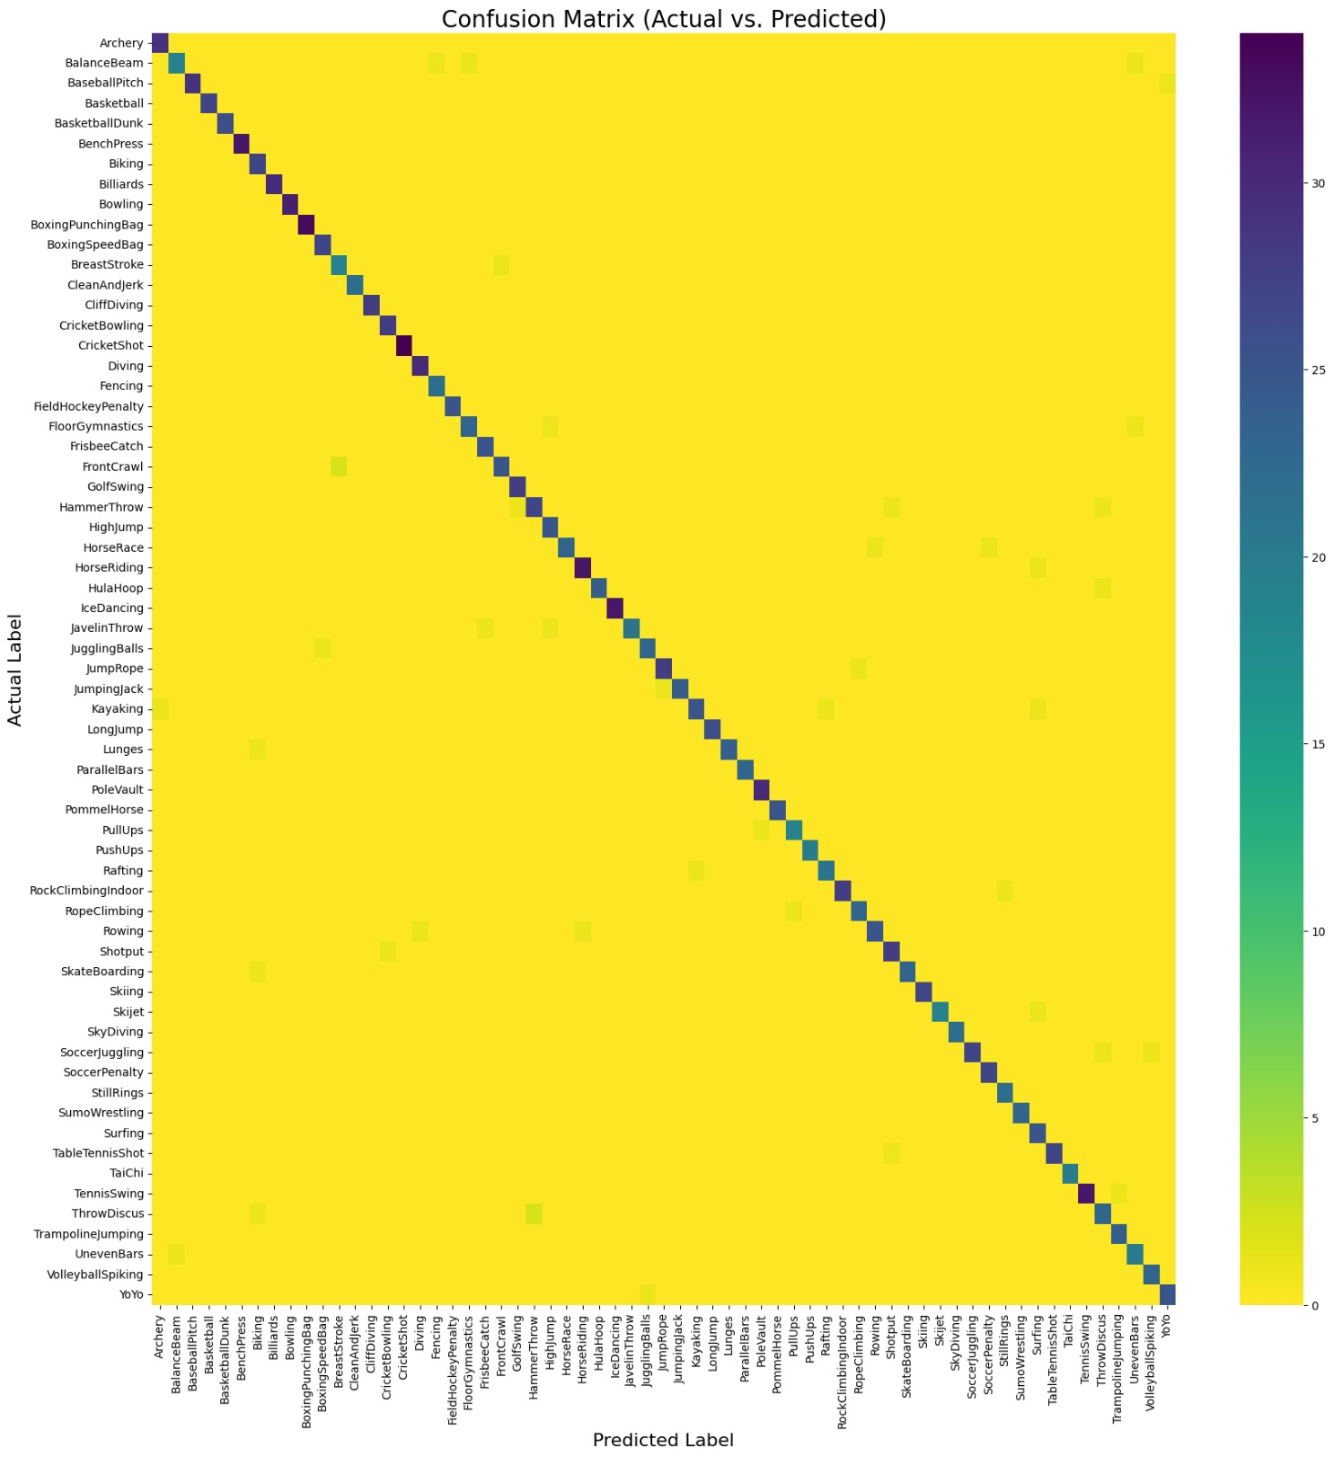
Confusion matrix

Slide 25
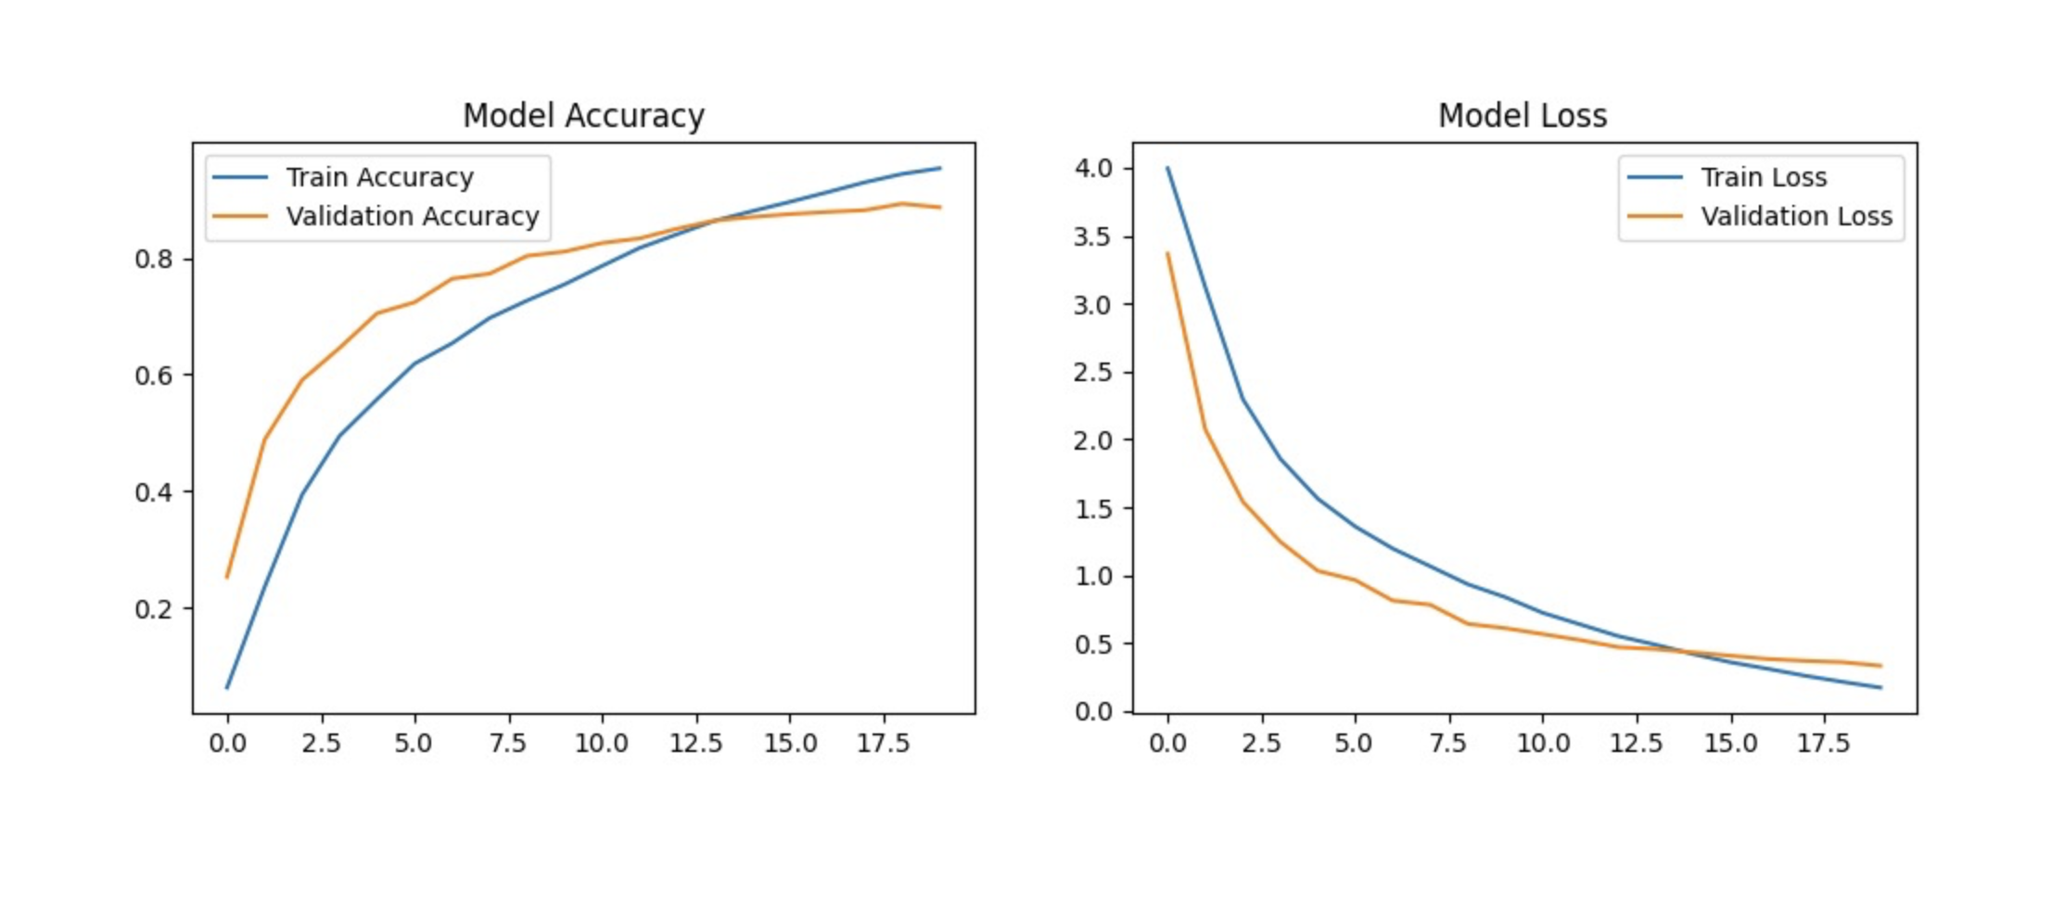
Results Accuracy and loss

Slide 26
Applications
Sports Analytics :
Automatically detects and classifies player actions (e.g., batting, dribbling, smashing).
Useful for performance tracking, highlights extraction, and event analysis.
Smart Surveillance Systems :
Detects abnormal or suspicious human movements in real-time.
Can alert authorities to accidents or violence in monitored zones.

Slide 27
Limitations
Needs labeled data, struggles under occlusion/low light, not multi-person yet.
Requires GPU for faster training
Struggles with occlusions or poor lighting
Dependent on quality of frame extraction
May misclassify overlapping sports motions

Slide 28
Future Work
Incorporate 3D CNN for spatiotemporal learning
Use transformer-based models
Extend dataset for more sports categories
Optimize for edge devices (Jetson, Raspberry Pi)

Slide 29
Conclusion
Transfer Learning + LSTM → 89.3% accuracy on UCF101; suitable for real-world sport recognition.
The accuracy gets improved after multiple epochs done on a regular basis.
A hybrid CNN-LSTM Transfer Learning model was developed to recognize human sports actions from video data.
Achieved 89.3% accuracy, outperforming traditional CNN methods.
Demonstrates strong potential for real-time sports analytics and surveillance applications.

Slide 30
References
1. IEEE Journal on Human action recognition based on transfer learning approach.
2. Grenze international journal on transfer learning based human activity recognition. 3. Tran et al., 2015. 4. UCF101 Dataset, 2012. 5. Recent TL-HAR papers 2020–23.

